Slide 1
EDUp FORDCS V1.0 Project
Vienna, April.2022
Edu Platform
MSc. Ömer Karacan
karacankos@gmail.com
Template v2022.04

Slide 2
Project Stream + Status (→ open/wip/done)
Describe the Project
Describe project Purpose → done
Describe project Requirements → done
Describe project Technical Scope → open
Describe Project Setup → open
Describe project Delivery → open
Define project Artifacts → open
Describe project Additional Considerations → open
Maintain project References → open
Define and Describe Annex (if any) → open
Create Artifacts
Maintain the Artifacts slide → open
Setup Development Environment and DevOps
Describe Project Setup → open
Use DevOps Template → open
System Requirements and Architectural Design
According to Templates → open
Validate & Verify
According to Templates → open
Implement
Component Code → open
Test Code → open

Slide 3
Project Purpose
To implement and test the FORDCS V1.0 based on customer requirements and Swagger API design!
Implementation and testing should be done on premise
The app should be deployed to Azure Cloud!

Slide 4
Project Requirements
The customer requirements are defined in a set of slides!
EDUp-FORDCS-V1.0 Customer-Requirements-v2022.04.pptx
The FORDCS V1.0 API is designed by a Swagger API!
The app should offer a Swagger document API!
The app should be deployed to Azure Cloud!
The acceptance test should be conducted while app is running on Azure Cloud!

Slide 5
Project Technical Scope

Slide 6
Project Setup

Slide 7
Project Delivery

Slide 8


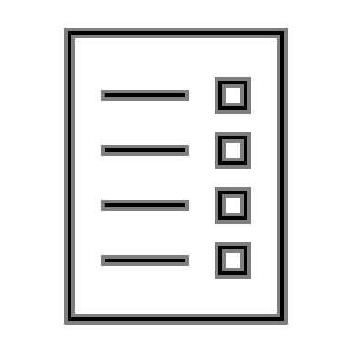






FORDCS-V1.0 Project Artifacts
<project>
Customer Requirements Document
<project>
Test Code
Project Setup Work-stream
FORDCS-V1.0
EDUp FORDCS-V1.0 Project-v2022.04
FORDCS-V1.0
EDUp-FORDCS-V1.0 Customer-Requirements-v2022.04.pptx
<project>
Validation Test Specification
Requirements Analysis Work-stream
<project>
System Requirements Specification
Acceptance Test Work-stream
<project>
Validation Test Specification
<project>
System Requirements Specification
System Test Work-stream
<project>
Test Code
<project>
Test Code
Architecture Design Work-stream
<project>
Architecture Design Specification
Test Code Work-stream
<project>
Architecture Design Specification
<project>
Validation Test Specification
Integration Test Work-stream
DevOps Document
Implementation Work-stream
<project>
Component Code
<project>
Verification Test Specification
<project>
DevOps Document
<project>
Component Code
DevOps Work-stream
Unit Test Work-stream
Cycles
Text Template: <artifact-name> work-stream)

Slide 9
Additional Considerations

Slide 10
References

Slide 11
<Annex - > <topic name>>

Slide 12
Project Glossary

Slide 13
IDEA: funnel template is a check-list!
roles are important
customer deivers only the use cases --> customer req doc
assumption: customer has not technically profonde knowledge over the FORDCS
WHO is customer? SmartCity Gov!!??!!
EDUp is the supplier, has knowledge about the FORDCS
EDUp sys-req contains req-analysis based on use-use-cases --> state machine models and swagger design --> (analysis phase)
swagger design is input for validation test spec
Project STORY : Analysis design dev -- devops -- test : Dev Life-Cycle Story & PM story (work-funnels)

Slide 14
Backyard

Slide 15
EDUp Project Story Stream Checklist
The < project-name>
Customer Scope
Define the system boundaries
Define the scope of the customer needs/requirements
Describe the needs from the viewpoint of customer (use case, swagger-UI, UX, big-picture)
Define the customer's knowhow profile
Supplier (Project) Scope
Define the system requirements from the viewpoint of supplier (describe with the means of Supplier's technology, tools, ..., HW/SW big-picture)
Define the supplier's knowhow profile
Define a project roadmap (project timeline)
Create artifacts according to EDUp-Full-Stack-Software-Project-Development-Method.pptx
See slide “Full-Stack Software Project Development Method” (#4)
Define the sys/sw-architecture covering the sys-req component-wise (SOA, component-based arch, domain model)
Define alternative solutions and references
Define the components based on Spring architecture
Define DevOps (the dev-env and dev-ops)
Define V&V-spec and -env
Define Deployment (deliverables, release content and media)

Slide 16
EDUp Project Story Stream
00
00
00
00
Customer Scope
00
00
00
00
Supplier Scope
User Scope

